Slide 1
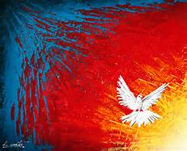
SHAVUOT/PENTECOST

Slide 2
WONDER AMAZEMENT HOLY SPIRIT IN US
IT IS TOO WONDERFUL FOR ME.

Slide 3
THREE SEGMENTS
INTRODUCTION
THE NINE PARALLES
PENTECOST WHAT IS IT, WHY IS IT IMPORTANT, HOW IS IT SYMBOLIZED, A CHALLENGE TO LIVE WITH “ WONDER” “AMAZEMENT” VIA THE TRUTH THAT GOD’S SPIRIT LIVES IN US!

Slide 4
SECTION ONE INTRODUCTION

Slide 5
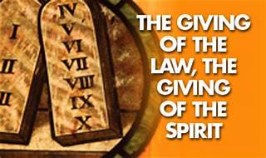
Pentecost/Shavuot

Slide 6
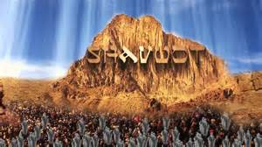

Slide 7
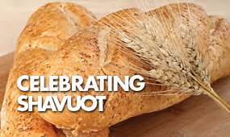

Slide 8
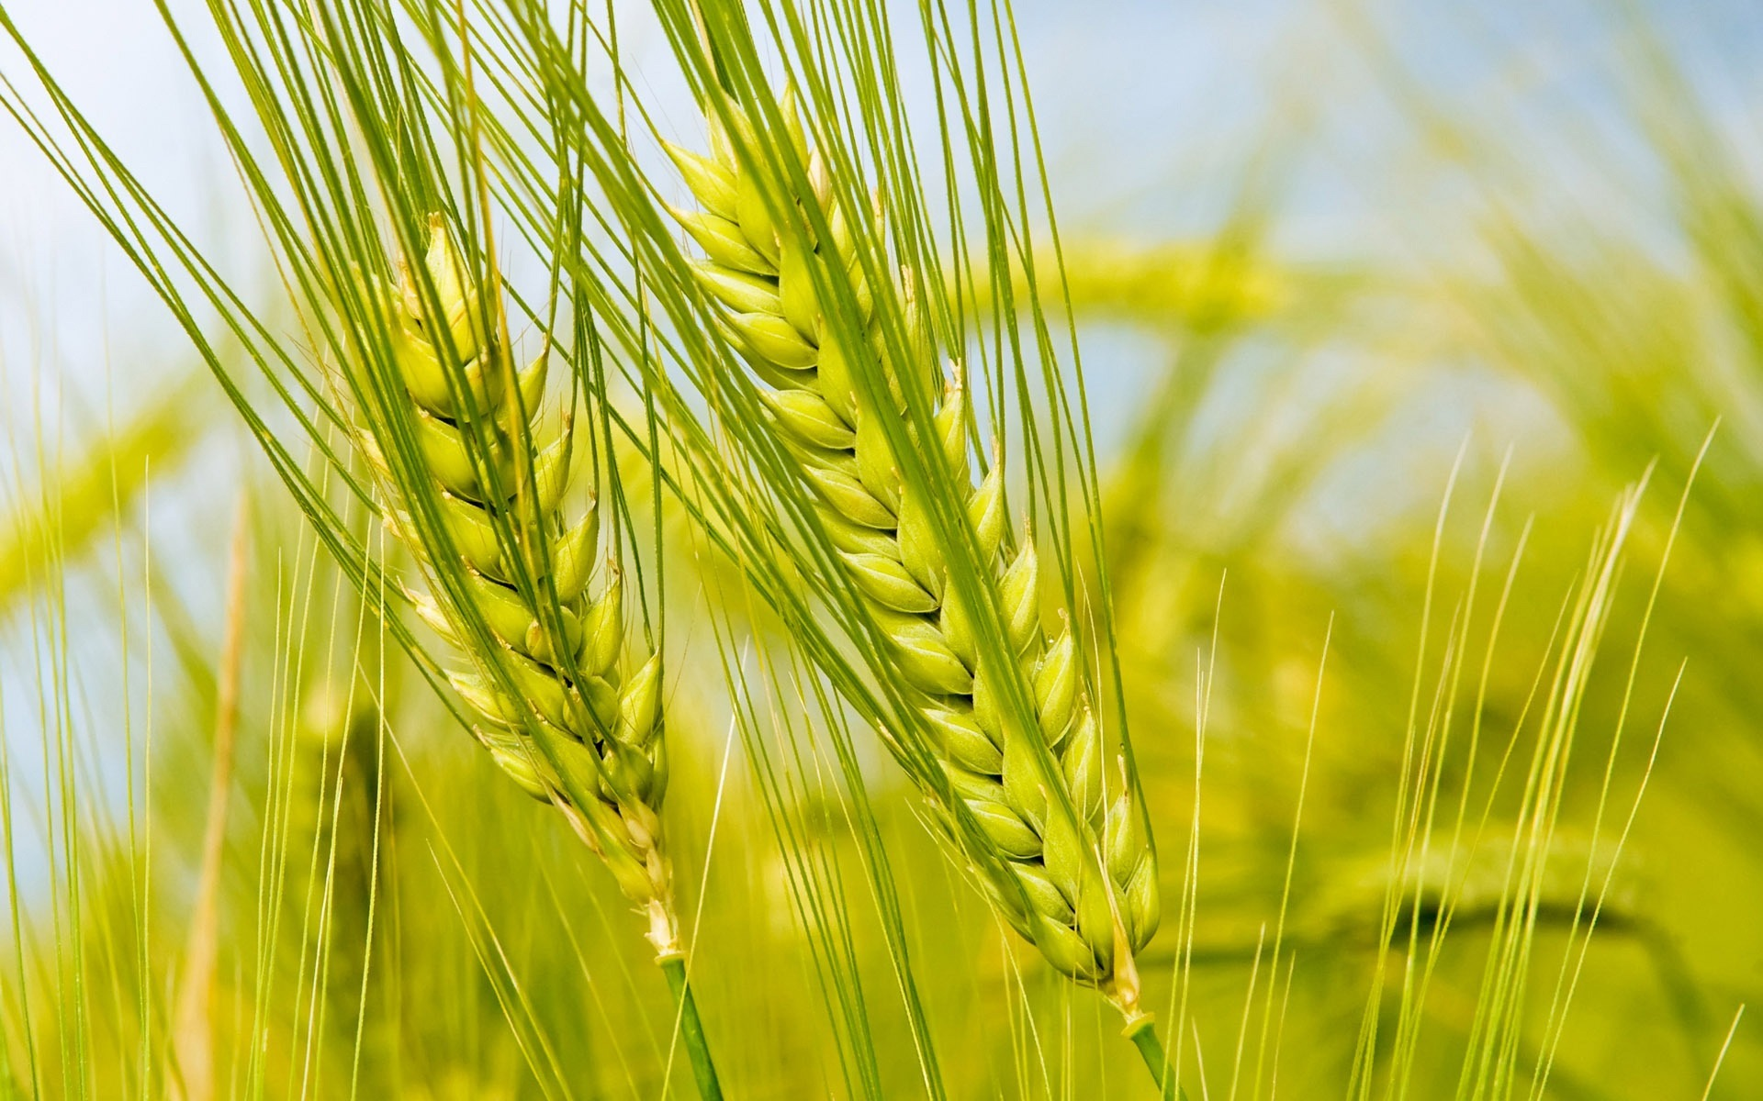
WHEAT
John 12:24 Very truly I tell you, unless a kernel of wheat falls to the ground and dies, it remains only a single seed. But if it dies, it produces many seed.
Notes:
John

Slide 9
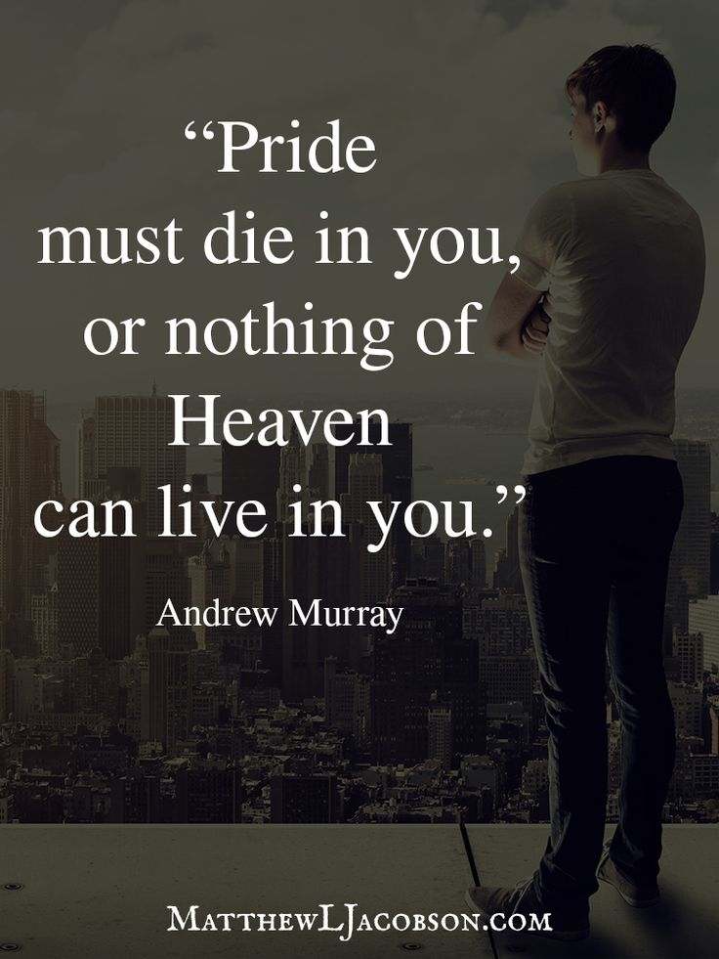
DIE TO LIVE
Galatians 2:20 I have been crucified with Christ and I no longer live, but Christ lives in me.

Slide 10
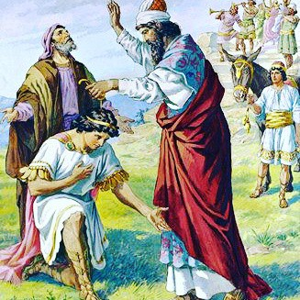
KING UZZIAH
2 Chronicles 26. ….. For he was greatly helped until he became powerful.

Slide 11
KING UZZIAH 2 Chronicles 26

Slide 12
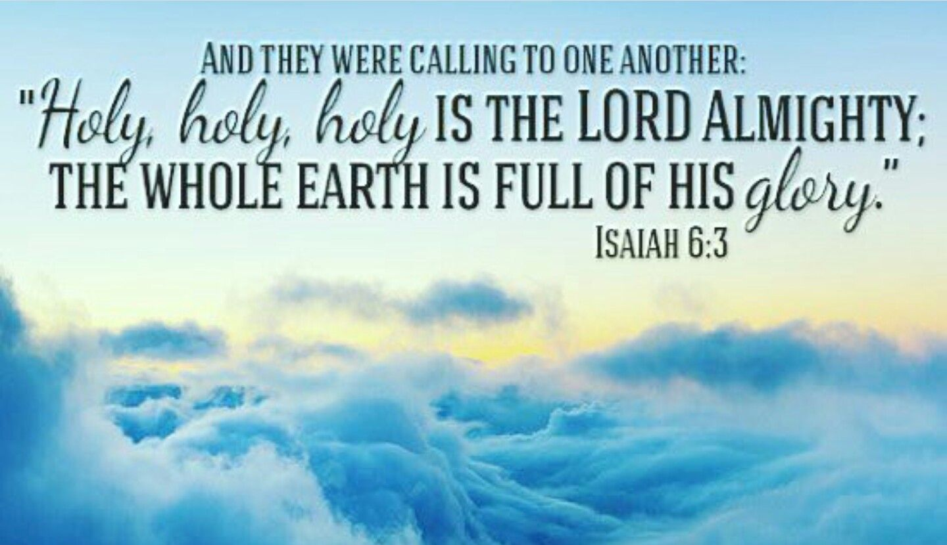
PENTECOST= HOLINESS
Isaiah 6. In the year that King Uzziah died, I saw the Lord, high and exalted, seated on a throne; and the train of his robe filled the temple.
And they were calling to one another: Holy, Holy, Holy is the Lord Almighty.

Slide 13
DIE TO SELF
Jesus is the model of dying to self.
We are to follow THE MASTER!!

Slide 14
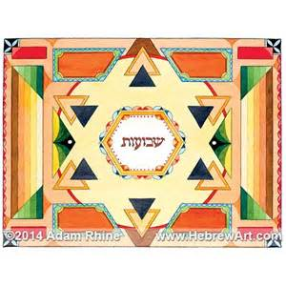
Passover to Pentecost
In Passover Jesus is our peace through the blood of the Lamb.
In Pentecost Jesus’ spirit is our power to walk victoriously.

Slide 15
Synonyms of the Feast
Shavuot
The Feast of Harvest
The Feast of Weeks
Pentecost

Slide 16
Why Study the Feasts?
Because:
1. They are a shadow of things to come. They point to Christ who is the substance.
~Colossians 2:16-17, Hebrews 10:1-2.~
2. Christ came to fulfill all that was written about him in the “Law, the Psalms , and the Prophets.” ~Luke 24:26-27.~
3.The law was a schoolmaster to bring us to Christ. ~Galatians 3:24.~
4. They set forth ‘patterns’ of heavenly things on earth. ~Hebrews 8:5.~
5.The truths contained in the Feasts are part of the present truth which the Holy Spirit is awakening to the Church in these last days.( 2 Peter 1:12, Matthew 4:4)

Slide 17
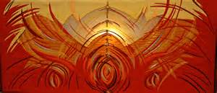
The Things Revealed
~Deuteronomy 29:29~ The secret things belong to the Lord our God, but the things revealed belong to us and to our children forever, that we may do all of the words of this law.
The Feasts are revealed as snapshots of the Lord Jesus Christ.

Slide 18
Jesus Christ in the Feasts
Passover…………….The Lamb of God
Unleavened Bread….Bread of Life
First fruits ………… .The Resurrected One
Pentecost ……………The Spirit of Christ
Trumpets…………. ...God is a Warrior
Atonement………….. Our Great High Priest
Tabernacles…………..Emmanuel

Slide 19
MEET THREE TIMES A YEAR
~Deuteronomy 16:16~ Three times a year all your men must appear before the Lord your God at the place he will choose: at the Festival of Unleavened Bread , The Festival of Weeks and the Festival of Tabernacles. No one should appear before the Lord empty handed: Each of you must bring a gift in proportion to the way the Lord your God has blessed you.
~ Exodus 34:22~ Three times a year all your men are to appear before the Sovereign Lord, the God of Israel.

Slide 20
Shavuot

Slide 21
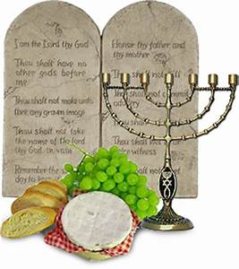
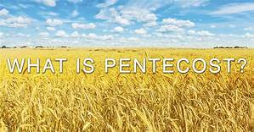
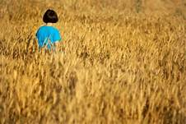
THE LAW/THE SPIRIT

Slide 22
Three Times a Year Leviticus 23
The Feast of Passover
The Feast of Unleavened Bread …….SPRING
The Feast of the Sheaf of Firstfruits
The Feast of Weeks ( Pentecost)…….SUMMER
The Feast of Trumpets
The Feast Day of Atonement……..AUTUMN
The Feast of Tabernacles

Slide 23
What is the Law?
1.The Law, Moral, and Civil. ( Deut 4:10; 5:12)
2.The Tabernacle of Moses. ( Exodus25-40)
3. The Sacrificial Offerings. ( Leviticus 1-7)
4. The Aaronic and Levitical Priesthood
( Ex 28-29; Leviticus 8-9)
5. The Feasts of the Lord.
( Leviticus 23, Deuteronomy 16)

Slide 24
First Covenant Feast of the Giving of the Law
The Birthday of the Giving of the Law.
The Birthday of Judaism.
Exodus 19:16-20. Deuteronomy 4-5. Exodus 31-34.
On the 50th day the Lord wrote with his finger on the two tablets of stone.
Relative to the giving of the Old Covenant commandments, and the people breaking the same by idolatry , 3000 people were slain.
When the Tablets were renewed, the face of Moses, their Mediator, shone with the Glory of God.

Slide 25
Birthday of the New Covenant Church
Birthday of the Giving of the SPIRIT.
The Birthday of the Church.
The New Covenant commandments are now to be written by the Spirit, ( the finger of God ).
(Luke 11:20; Matthew 12:28)
Written on fleshly tablets of the heart and mind.
“I will put my laws in their minds and write them on their hearts.” Jeremiah 31:31-34 and Hebrews 8.
At Pentecost, after Peter’s teaching, 3000 people were saved and given new life in the Spirit.

Slide 26
Section two nine parallels

Slide 27
First Parallel 50th Day The Morrow after the Sabbath
~ Leviticus 23:4, 15, ~These are the Lord’s appointed festivals, the sacred assemblies you are to proclaim at their appointed times. From the day after the Sabbath, the day you brought the sheaf of the wave offering, count off seven full weeks.
7 x7 =49 +1= 50
The time for the Festival of Weeks, Festival of Harvest, the Giving of the Law

Slide 28
New Testament 50th day
~ Acts 1:3,2:1~ The Lord Jesus came to fulfill all the intricate details of the Law. ( Matt 5:17-18, 11:13) The Book of Acts shows the time period of 50 days from the Passover week until the Feast of Pentecost.
After Christ’s resurrection He was seen by the disciples for 40 days, speaking to them about things pertaining to the kingdom of God. At the close of this period, He ascended back to the Father. The disciples waited 10 days until “the time of Pentecost had fully come”--- then the Holy Spirit was poured out on the believing and waiting disciples. ( Acts 1 and 2)
40 days post resurrection plus 10 days waiting=50.

Slide 29
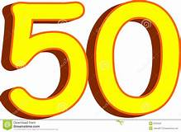
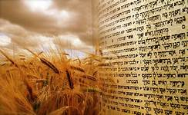
Counting the Omer

Slide 30
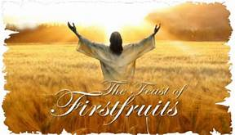
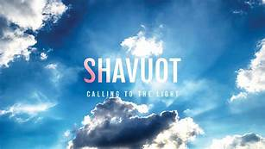
LIGHT!!!

Slide 31
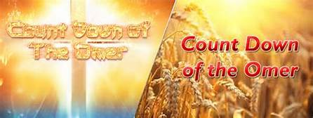
Passover to Pentecost

Slide 32
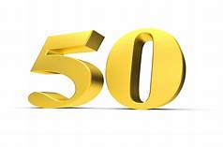
Significance of
The number 50 is used symbolically to represent liberty, freedom ,or deliverance. This is seen in the Year of Jubilee. Slaves were set free, debts were cancelled, families were reunited and liberty was proclaimed throughout the land by the sound of the Jubilee trumpets( Leviticus 25:8-17)
For the nation of Israel , the Feast of Pentecost meant liberty and freedom from the ceremonialism of the law. It meant freedom in the liberty wherewith Christ had set them free. It meant they were at liberty to serve the Lord, not in the oldness of the letter, but in newness of the Spirit.
Romans 7:1-6

Slide 33
Jubilee
When Jesus began his ministry He spoke of His six fold ministry of Jubilee in Luke 4 and Isaiah 61.
1.To preach good tidings to the poor and meek.
2.To heal and bind up the broken hearted.
3.To preach deliverance to the captives and open prison doors.
4.To recover sight to the blind.
5.To set at liberty the bruised.
6. To proclaim the year of the Lord…year of release.
Christ our Redeemer releases
these things through His Spirit.

Slide 34
Second Parallel Supernatural Manifestations Pentecost of Exodus
~ Exodus 19:16,18 19b~ On the morning of the third day there was thunder and lightning, with a thick cloud over the mountain and a very loud trumpet blast. Mount Sinai was covered with smoke, because the Lord descended on it in fire. Moses spoke and the voice of God answered him.~
As Moses entered the mount of God , supernatural manifestations took place. The Presence of God was evidenced by the sound of the trumpet, by thunders, lightning, thick clouds, fire and a voice.

Slide 35
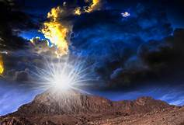
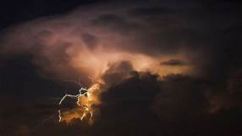
Mt Sinai

Slide 36
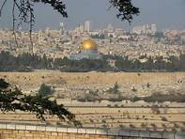
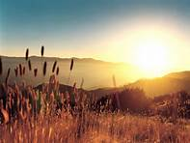
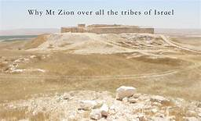
Mt Zion

Slide 37
Supernatural Manifestations Pentecost of Acts
~Acts 2:1-4.~ When the day of Pentecost came they were all together in one accord. Suddenly a sound like the blowing of a violent wind came from heaven and filled the whole house where they were sitting. They saw what seemed to be tongues of fire that separated and came to rest on each of them. All of them were filled with the Holy Spirit and began to speak in other tongues as the Spirit enabled them.~
After Jesus, the Mediator of the New Covenant had entered the mount of God –Mount Zion (Hebrews 12:22-29, Rev 14:1-4), there were manifestations of His Presence. Fear and wonder fell on the hearers as the gospel was preached.

Slide 38
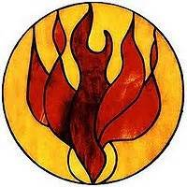
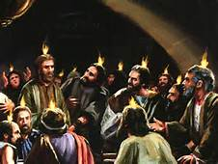
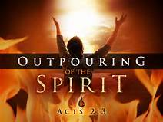

Slide 39
Third Parallel Mt Sinai/Mt Zion
~ Hebrews 12:18-21~ For you have not come to a mountain that may be touched and to a blazing fire and to darkness and gloom and whirlwind, and to a blast of a trumpet and the sound of words which sound was such that those who heard begged that no further word should be spoken to them. For they could not bear the command, ”If even a beast touches the mountain it will be stoned.” And so terrible was the sight , that even Moses said, “ I am full of fear and trembling.”

Slide 40
Mount Zion
~Hebrews 12:22-25a~ But you have come to Mount Zion and to the city of the living God, the heavenly Jerusalem, and to myriads of angels and to the general assembly and church of the first-born who are enrolled in heaven, and to God the Judge of all, and to the spirits of righteous men made perfect, and to Jesus the mediator of a new covenant and to the sprinkled blood, which speaks better than the blood of Abel. See to it that you do not refuse him who is speaking.

Slide 41
Fourth Parallel Written by the Finger of God
~ Exodus 31~ When the Lord finished speaking to Moses on Mount Sinai, he gave him the two tablets of the covenant law, the tablets of stone inscribed by the finger of God.
~ Deuteronomy 9:10~ The Lord gave me two stone tablets inscribed by the finger of God. On them were all the commandments the Lord proclaimed to you on the mountain out of the fire, on the day of assembly.

Slide 42
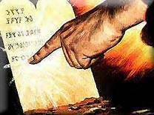
The Finger Of God

Slide 43
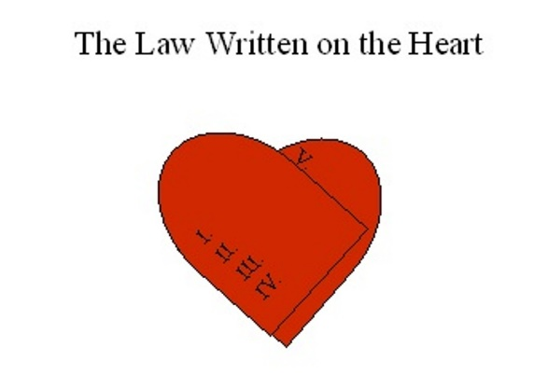
Written By the Spirit
~ 2 Corinthians 3:2-4, 6~ You yourselves are our letter , written on our hearts , known and read by everyone. You show that you are a letter from Christ, the result of our ministry, written not with ink but with the Spirit of the living God, not on tablets of stone but on tablets of human hearts . He has made us competent ministers of a new covenant ---not of the letter but of the Spirit; for the letter kills, but the Spirit gives life.

Slide 44
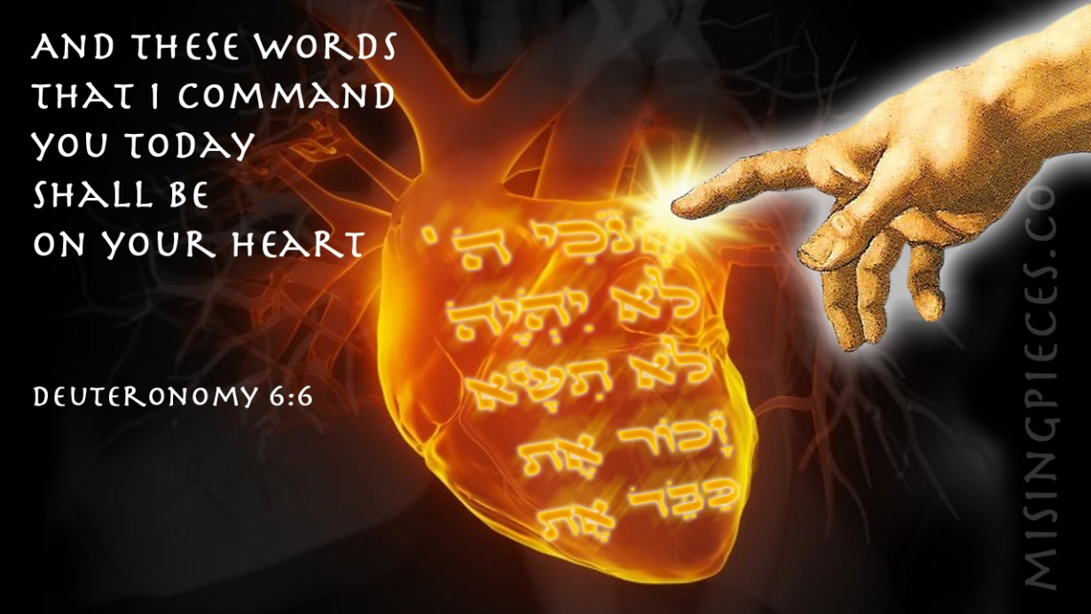

Slide 45
Fifth Parallel The Law Instructs
~Deuteronomy 31:12,13; 24-26, Assemble the people --- men, women and children, and foreigners residing in your towns– so that they can listen and learn to fear the Lord your God and follow carefully all the words of this law. Their children, who do not know this law, must hear it and learn to fear the Lord your God. After Moses finished writing in a book the words of this law from beginning to end, he gave this command to the Levites who carried the ark of the covenant of the Lord. “ Take this Book of the law and place it beside the ark of the covenant of the Lord your God.”

Slide 46
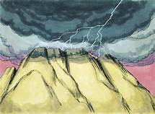
THE LAW

Slide 47
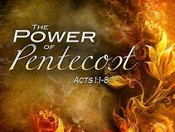
Holy Spirit Instructs
~ Acts 1:8~ But you will receive power when the Holy Spirit comes on you; and you will be my witnesses in Jerusalem, and in all Judea and Samaria, to the ends of the earth”
~ Acts 4:31~ After they prayed , the place where they were meeting was shaken . And they were filled with the Holy Spirit and spoke the word of God boldly.~

Slide 48
The Holy Spirit Instructs
John 14:17. But the Advocate, the Holy Spirit, whom the Father will send in my name, will teach you all things and will remind you of everything I have said to you.
John 16:13. But when he, the Spirit of truth, comes, he will guide you into all truth.

Slide 49
Sixth Parallel The Glory of God on the Face of Moses
“When Moses came down from Mount Sinai
with the two tablets of the covenant law in his hands , he was not aware that his face was radiant because he had spoken with the Lord. When Aaron and all the Israelites saw Moses, his face was radiant, and they were afraid to come near him.” Exodus 34: 29-30.

Slide 50
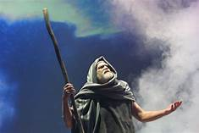
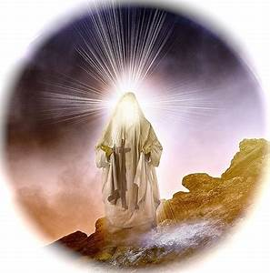
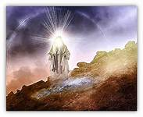
Glory on the Face of Moses

Slide 51
Glory of God in the Face of Jesus
Paul tells us that the Glory of God in the face of Jesus Christ is the greater Glory than that on the face of Moses.
“Now if the ministry that brought death , which was engraved in letters of stone, came with glory, so that the Israelites could not look steadily at the face of Moses because of its glory, transitory though it was, will not the ministry of the Spirit be even more glorious?”
2 Corinthians 3:7-8.

Slide 52
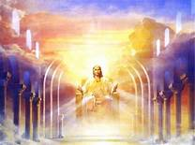
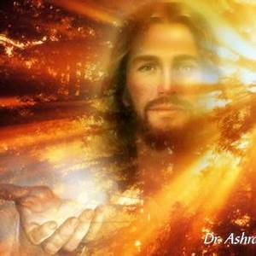
The Glory Of Jesus

Slide 53
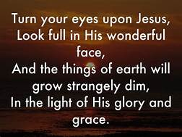
HIS FACE

Slide 54
Seventh Parallel Glory to Glory
~ 2 Corinthians 3:17-18~ Now the Lord is the Spirit, and where the Spirit of the Lord is , there is freedom. And we all, who with unveiled faces contemplate the Lord’s glory , are being transformed into his image with an ever increasing glory which comes from the Lord, who is the Spirit.

Slide 55
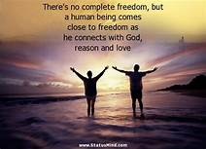
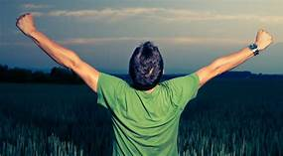
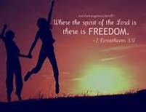
FREEDOM

Slide 56
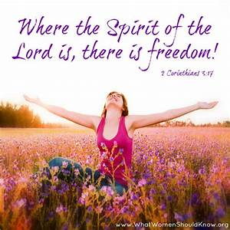
Freedom

Slide 57
GLORY
1. Glory of the Lord appeared to Israel.
Exodus 16,24. ( looked like consuming fire)
2.The Glory of the Lord filled the Tabernacle and the Temple on the day of dedication. Exodus 40, I Kings 8, 2 Chronicles 5.
3. Moses beheld the glory of the Lord and had the same seen on his face. Exodus 33, 2 Corinthians 3.
4.Jesus shone with the glory of God on the Mt of Transfiguration. Matt 17:1-8, 2 Peter 1:17-18.
5. The church is to shine with the glory of God. Isaiah 60:1-3, Colossians 1:27, Ephesians 5:27.

Slide 58
The Glory of the Lord
Entrance within the veil, by the power of incense and the atoning blood brought Aaron into the very presence and glory of the Lord. The Hebrews referred to this visible manifestation of God’s Presence as “the Shekinah.”
Aaron entered into the glory of the Lord. In fulfillment of this we see the Lord Jesus Christ in His ascension was ‘received up into glory’ ( I Timothy 3:16) and He was glorified with the glory which He had with the Father before the world began ( John 17:1-5, 24-26).

Slide 59
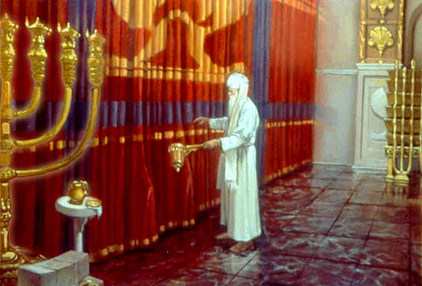
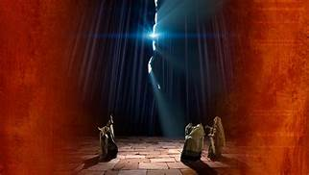
Entrance Within the Veil

Slide 60
Glory Fills the Earth
~Isaiah 6:3~ Holy, holy, holy is the Lord God Almighty; the whole earth is full of his glory.
~ Isaiah 40:5~ And the glory of the Lord will be revealed and all people will see it together. For the mouth of the Lord has spoken.
~ Habakkuk 2 :14~ For the earth will be filled with the knowledge of the glory of the Lord as the waters cover the sea.

Slide 61
Fire/Holy Spirit
~Isaiah 50~ But now, all you who light fires and provide yourselves with flaming torches, go , walk in the light of your own fires and of the torches you have set ablaze.
~ Mark~ Peter followed him at a distance , right into the courtyard of the high priest . There he sat with the guards and warmed himself at the fire
~ Matthew 3~ He will baptize you with the Holy Spirit and fire.
~Acts 2~ Then Peter stood up with the Eleven…..

Slide 62
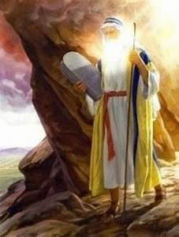
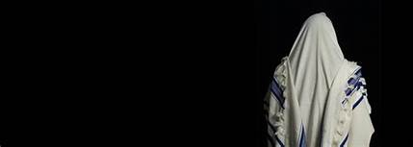
Eighth Parallel Face Veiled/ Unveiled Face
But whenever he entered the Lord’s presence to speak with him, he removed the veil until he came out. And when he came out and told the Israelites what he had been commanded they saw that his face was radiant. Then Moses would put the veil back over his face until he went in to speak with the Lord. Exodus 34:34-35.

Slide 63
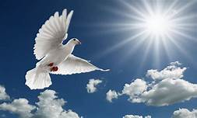
Unveiled Face
Now the Lord is the Spirit , and where the Spirit of the Lord is, there is freedom. And we all, who with unveiled faces contemplate the Lord’s glory, are being transformed into his image with an ever –increasing glory, which comes from the Lord, who is the Spirit. 2 Corinthians 3: 17-18.

Slide 64
Passover / Calvary
Matthew 26: 67-68.
They spit in his face and struck him with their fists. Others slapped him and said, “Prophesy to us, Messiah. Who hit you?”
Pentecost
So that ( Your Name)_______ face can radiate the glory of God through the Spirit.
We all with unveiled faces contemplate the Lords glory, are being transformed into his image with ever increasing glory, which comes from the Lord, who is the Spirit.
2 Corinthians 3:18.

Slide 65
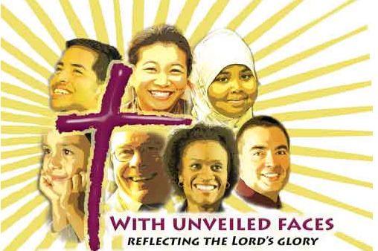
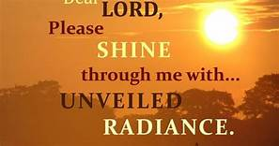
Radiant Faces

Slide 66
Ninth Parallel 3000 Die/3000 Live
The Levites did as Moses commanded, and that day about three thousand of the people died.
Exodus 32: 28.
Those who accepted his message were baptized, and about three thousand were added to their number that day. Acts 2:41.

Slide 67
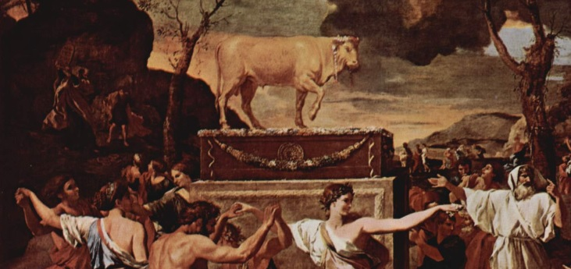
3000 Died

Slide 68
3000 Made Alive By the Spirit

Slide 69
Nine Parallels
50th day/50th day
Supernatural Manifestations/Supernatural Manifestations
Mt Sinai/ Mt Zion
Tablets of Stone/ Written on the Heart
Law Instructs /Spirit Instructs
Glory on the Face of Moses/ Glory on the Face of Jesus
Glory Related to the Law/Glory Related to the Spirit
Veiled / Unveiled
3000 Die/ 3000 Made Alive

Slide 70
SECTION THREE PENTECOST FOR YOU!
The Rain
The Harvest
The Wheat
The Wave Loaves
The Wave Offering
The Fine Flour
The Baked Leaven
The Blood

Slide 71
The Rain
There can be no harvest without rain. Rain is symbolic of revival and refreshing . Spiritually speaking it pointed to the outpouring of the Holy Spirit as the early and the latter rain. The Lord promised He would come to His people as the rain.
~ Hosea 6~ Let us acknowledge the Lord; let us press on to acknowledge Him, as surely as the sun rises, He will appear ; He will come to us like the winter rains like the spring rains that water the earth.

Slide 72
Rain
The Prophet Joel is the prophet of Pentecost.
~ Joel 2~ Be glad, people of Zion, rejoice in the Lord your God ,for he has given you the autumn rains because he is faithful. He sends you abundant showers, both autumn and spring rains, as before. I will pour out my Spirit on all people . Your sons and daughters will prophecy, your old men will dream dreams, your young men will see visions. Even on my servants , both men and women I will pour out my Spirit in those days. I will show wonders in the heavens and on the earth.

Slide 73
The Harvest
Under the early outpouring of the Holy Spirit there was a great harvest of souls , Great multitudes came to the Lord . There were 3000 souls then 5000 souls, then multitudes of men and women who came in during harvest period ( Acts 2:41-42, 4:4,5:14). Later on, as the rain of the Holy Spirit continued to be poured out there was a great harvest of Gentile converts. It was the fulfillment of the great harvest which Jesus saw. ( Matt 9:37-38, John 4:35).

Slide 74
A GRAIN OF WHEAT
Jesus spoke of himself as the fulfillment of this feast with the following words:
~ John 12:23-24~ The hour has come that the Son of man should be glorified . Most assuredly , I say to you , unless a grain of wheat falls into the ground and dies , it remains alone; if it dies , it produces much grain.”
As the wheat was crushed, sifted and baked in order to become bread, so Jesus was crushed, sifted for our sins.

Slide 75
Presentation of Wave Loaves
~ LEVITICUS 23:15-17 From the day after the Sabbath, the day you brought the sheaf of the wave offering , count off seven full weeks. Count off fifty days up to the day after the seventh Sabbath, then present an offering of new grain to the Lord. From wherever you live, bring two loaves made of two – tenths deal of the finest flour baked with yeast as a wave offering of first fruits to the Lord.

Slide 76
Tenoofaw Wave Offering
Instructions for a wave offering for Pentecost.
Leviticus 23:17,20. Two loaves as a wave offering.
A wave offering. Tenoofaw means shaking, wave offering, rock to and fro, vibrate up or down. {S.C.. 8573 and 5130}
On the day of Pentecost the 120 disciples filled with the Holy Spirit , were God’s “wave offering” for men thought they were drunk by the way they acted and spoke, Acts 2:1-4.~

Slide 77
TWO WAVE LOAVES
The two wave loaves speak of witness and testimony. In the mouth of two witnesses it must be established.
( Deuteronomy 19:15, Matthew 18:16-20.)
It also symbolizes the two ethnic divisions on which the Holy Spirit was poured out, making of both one new man.( I Corinthians 12:13.)
“We being many are one body and one bread”.
I Corinthians 10:16-17

Slide 78
Pentecost
Pentecost with its two wave loaves presented before the Lord on the fiftieth day after the waving of the sheaf of firstfruits sets forth the work of the Holy Spirit in the church composed of Jew and Gentile .
It shadows forth the Pentecostal age between the first and second advent of Christ.

Slide 79
Fine Flour
FINE FLOUR
Wheat is put through refining process. This is a prophetic picture of the trials, testings, temptations, and sufferings the believer has in order to become purified and die to self. In this way the glory shines.

Slide 80
Baked with Leaven
~ Leviticus 23:17~
The fire and the baking process intensify the unity of the loose flour.
So the fire of the Holy Spirit ( Hebrews 12:29, Matt 3:11-12) intensifies the unity of Jew and Gentile as the bread of God suitable to be waved before Him. ( Luke 3:16, Hebrews 9:14)
This also speaks of the fiery trials of faith for all saints to bind them together in one loaf, whether Jew or Gentile. ( Job 23;10, I Peter 1:6-7, Proverbs 3:9)

Slide 81
Jews and Gentiles Baptized in One Spirit are Christ’s Wave Offering
~ Corinthians 12:13. ~ For we were all baptized by one Spirit so as to form one body– whether Jews or Gentiles, slave or free--- and we were all given the one Spirit to drink.
~ Ephesians 2:13-18~ But now in Christ Jesus you who once were far away have been brought near by the blood of Christ. For He Himself is our peace, who has made the two groups one and has destroyed the barrier, the dividing wall of hostility, by setting aside in his flesh the law with its commands and regulations. His purpose was to create in Himself one new humanity out of the two, thus making peace , and in one body to reconcile both of them to the cross.

Slide 82
Revelation of the Tabernacle Order
~ Exodus 25-40~ Subsequent to the Feast Day of Pentecost was the revelation of Moses of the Tabernacle of the Lord and the whole order of approach and worship.
~ At Mt Sinai , God established His church ( Acts 7:38), the sacrificial system, the Tabernacle, the Festival occasions. Here Israel was taught how all must approach God in sacrifice and worship as a redeemed and holy people. Exodus 25-40, Leviticus 1-27.

Slide 83
A Statute Forever
~ Leviticus 23:21~ On this same day you shall make a proclamation as well; you are to have a holy convocation . You shall do no laborious work. It is to be a perpetual statute in all your dwelling places throughout all generations.
The Holy Spirit produces rest in the believer.
The Holy Spirit has come to dwell with the believer forever. The believer may have a continual Penetcost Feast. ( John 14:16-17)

Slide 84
Passover Pentecost Tabernacles
Passover~~~~~~~~~~~ barley
Pentecost~~~~~~~~~~wheat
Tabernacles~~~~~~~~~fruit

Slide 86
The Holy Spirit
1.The Spirit did not always reside:~ Psalm 51:11~ And do not take your Holy Spirit from me.
2.Just ask:~ Luke 11:13~ How much more will your heavenly Father give the Holy Spirit to those who ask Him?
3.You can recall: ~ John 14:26~ But the Helper the Holy Spirit, he will teach you all things.
4. Power: ~ Acts 1:8 ~ But you will receive power when the Holy Spirit has come upon you .

Slide 87
Holy Spirit
5.Increase: ~ Acts 9:31 ~ The Church……in the comfort of the Holy Spirit continued to increase.
6. Joy: ~ Acts 13:52 ~ And the disciples were continually filled with joy and with the Holy Spirit.
7.Tongues and Prophecy: And when Paul had laid his hands upon them , the Holy Spirit came upon them, and they began speaking with tongues and prophesying.

Slide 88
Holy Spirit
8. The Kingdom: ~ Romans 14:17 ~ The Kingdom of God…is righteousness and peace and joy in the Holy Spirit.
9. The Temple: ~ 1 Cor 6:19 ~ Your body is a temple of the Holy Spirit.
10. Sealed: ~ Ephesians 1:13 ~ You were sealed in Him with the Holy Spirit of promise.
11. Guard: ~ 2 Timothy 1:14 ~ Guard through the Holy Spirit who dwells in us, the treasure which has been entrusted to you.

Slide 89
The Holy Spirit
12. Gifts: ~ Hebrews 2:4 ~ God also testifying with them , both by signs and wonders and by various miracles and by gifts of the Holy Spirit according to His own will.
13. Sent from Heaven: ~ 1 Peter 1:12 ~ Have been announced to you through those who preached the gospel to you by the Holy Spirit sent from heaven--- things which angels long to look.
14. Pray: ~ Jude 1:20 ~ But you, beloved , building yourselves up on your most holy faith , praying in the Holy Spirit.

Slide 90
How can we walk in wonder and amazement that the power of the Living God is in us?
I Thessalonians 5:23-24.
HE WILL DO IT!

Slide 91
In Conclusion
Why do we celebrate Pentecost?
For the first time in human history we have the Sprit of Christ indwelling us! It is available to all who believe!!
We no longer “work” to comply with the Law.
He has given us the Comforter to transform us.
( Romans 12:2, I Thess 5:23-24 ) May God Himself, the God of Peace, sanctify you through and through. May your whole spirit, soul, and body be kept blameless at the coming of our Lord Jesus Christ. The One who calls us is faithful and He will do it.
The Old Testament saints did not have the ministry of the Holy Spirit as we do today.

